Slide 1
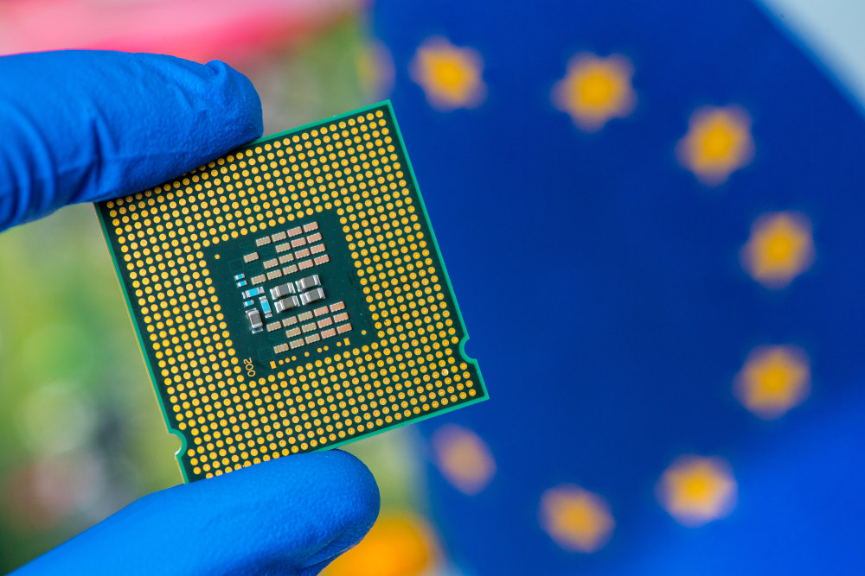
substituting
Why Europe’s Cloud Market Should Be Sovereign and Decentralised
David Sterz
david.sterz@denktmit.de
with
Let's build European Clouds on Souvereign Hardware beyond GPUs
Dr. Sven Köppel
sven.koeppel@denktmit.de

Slide 2
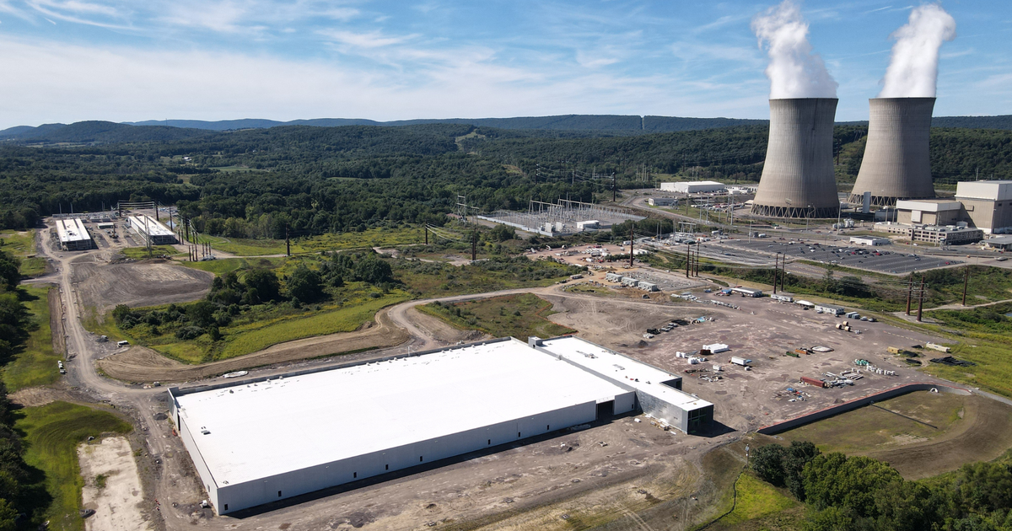
Urgent need
for compute

Slide 3
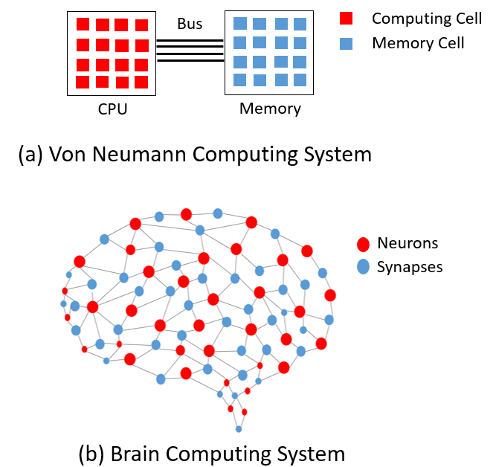
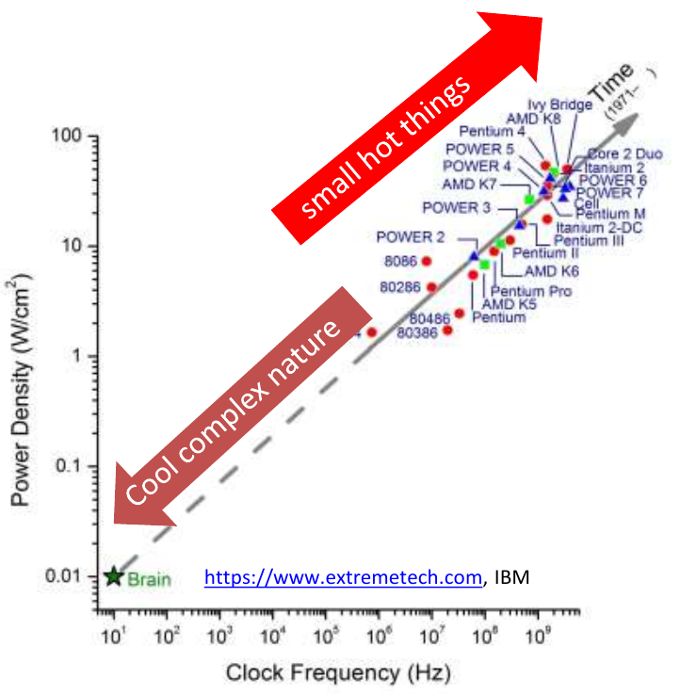
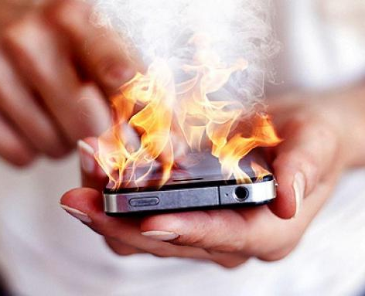
Current ways of doing AI are neither sustainable nor scalable

Slide 4
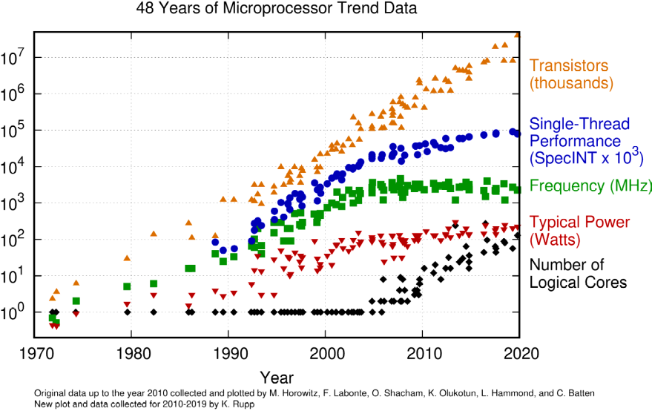

Slide 5

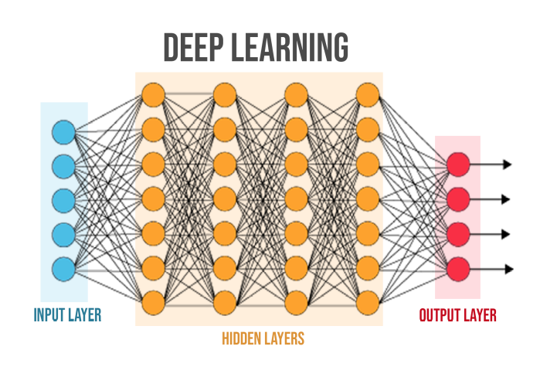
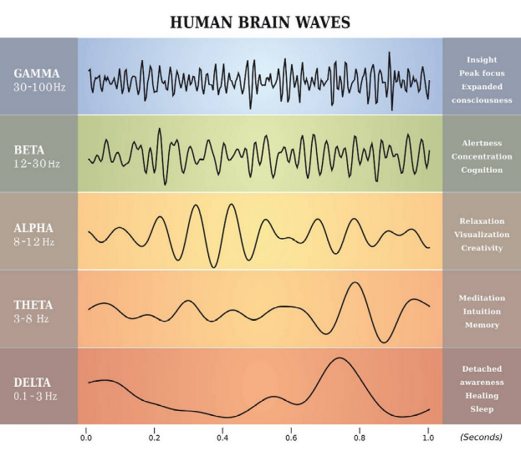
Compute as the Human Brain
Digital Arithmetics
Analog processes in nature
Symbolic computing & sparse linear algebra
Wave-based computing & dense interconnects

Slide 6
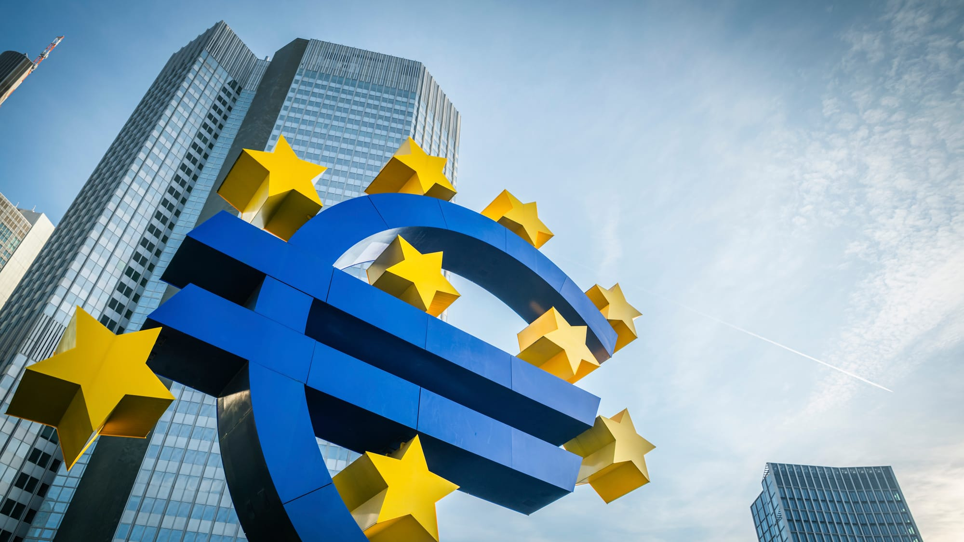
European tech
to the rescue

Slide 7
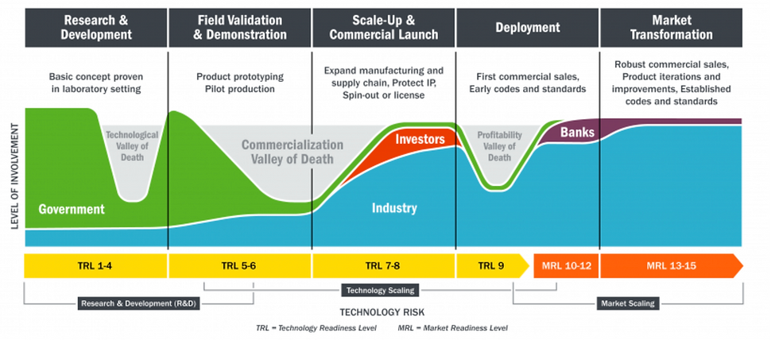











Digital/CMOS
Analog
Photonic
Quantum
In-Memory
Neuromorphic

Slide 8







Semiconductor R&D Public Funding Situation in Europe
Research
Application

Slide 9
Value Chain from Semi to Cloud
Chip
Package
Board
Drivers
Runtime
Cloud API
Application

Slide 10
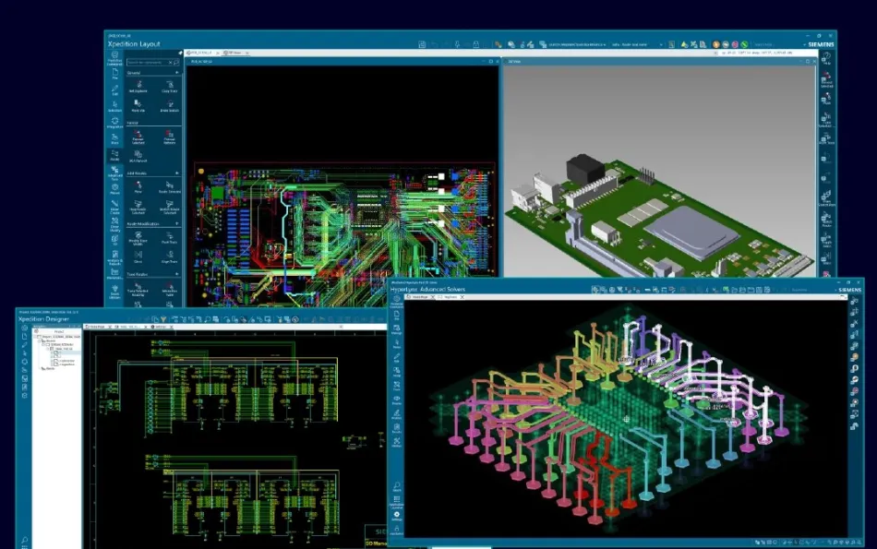
Value Chain from Semi to Cloud
Chip
Package
Board
Drivers
Runtime
Cloud API
Application

Slide 11
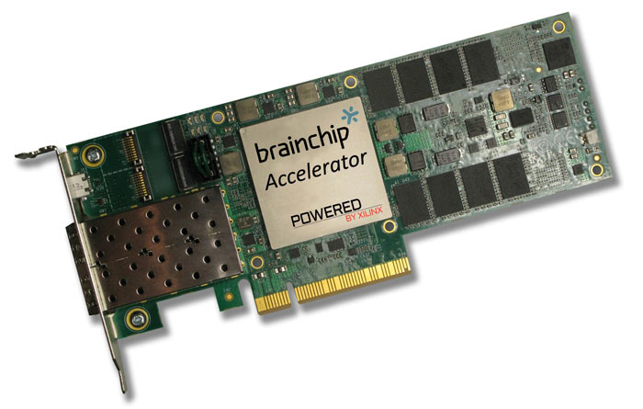
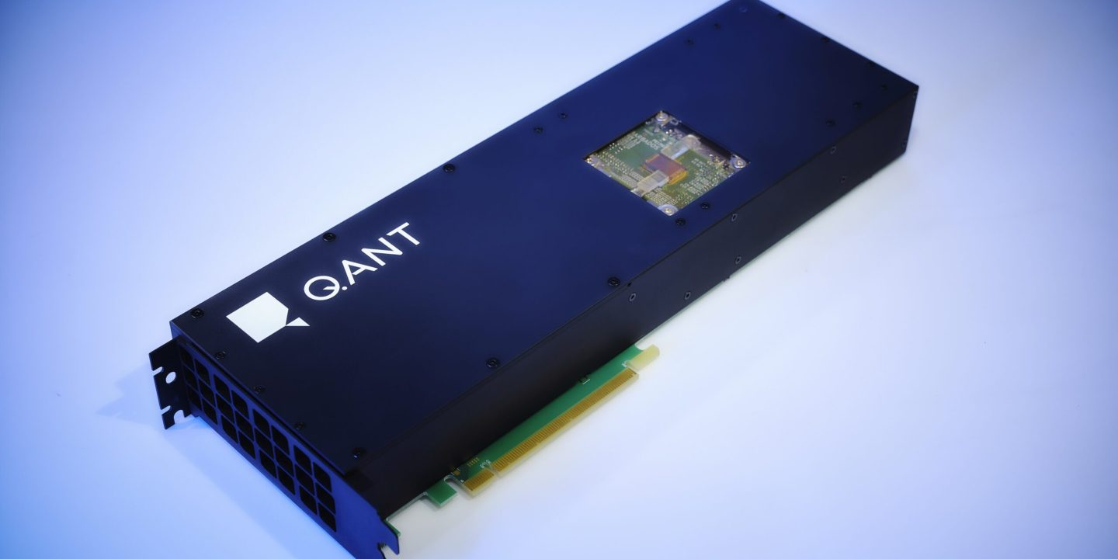
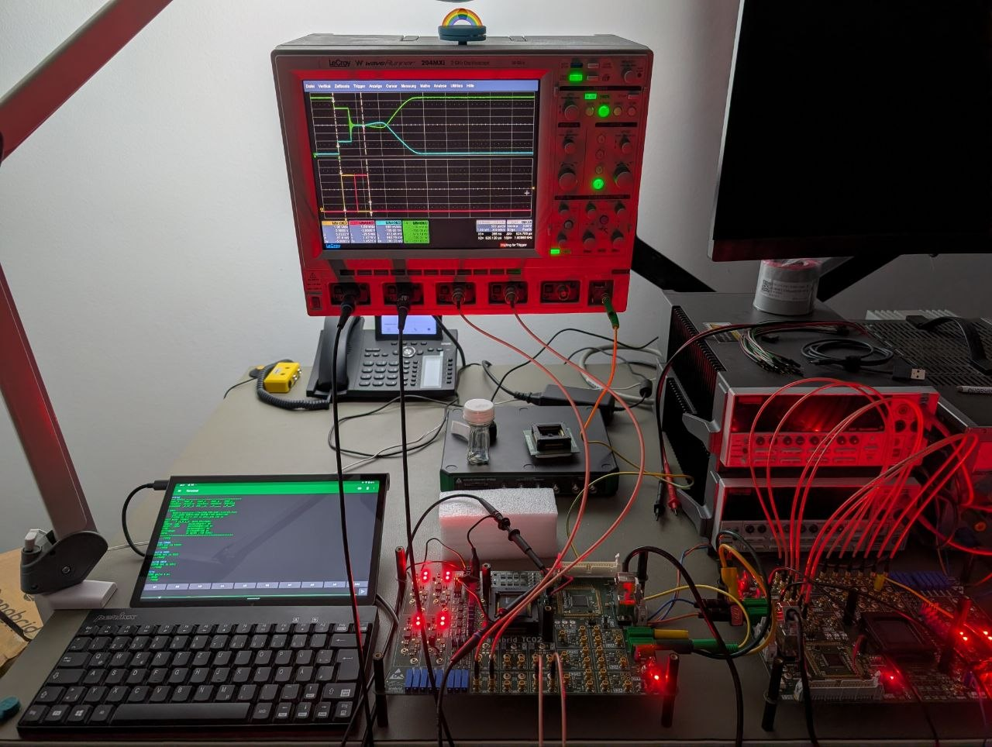
Value Chain from Semi to Cloud
Chip
Package
Board
Drivers
Runtime
Cloud API
Application

Slide 12
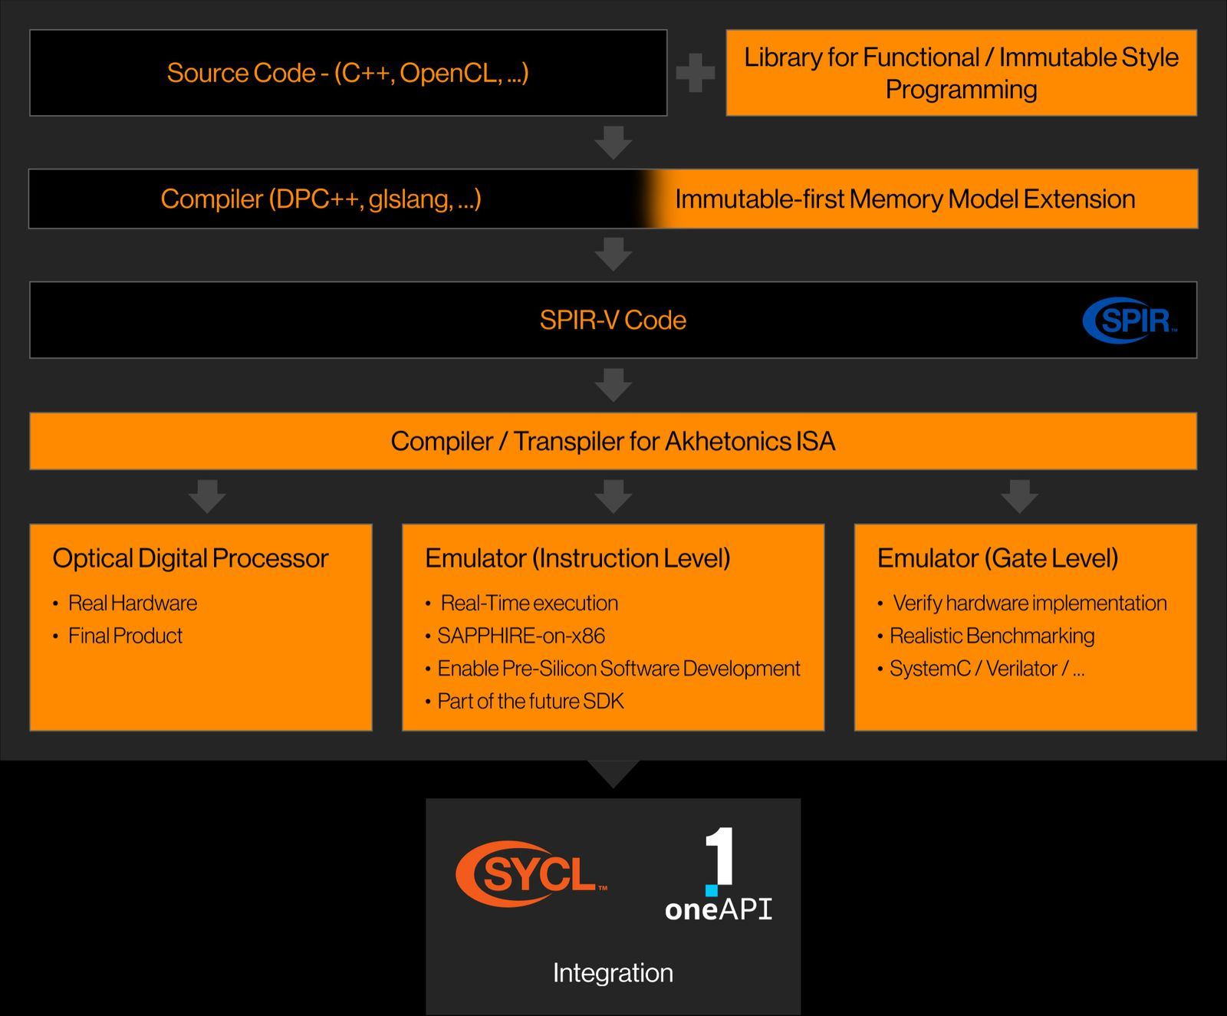


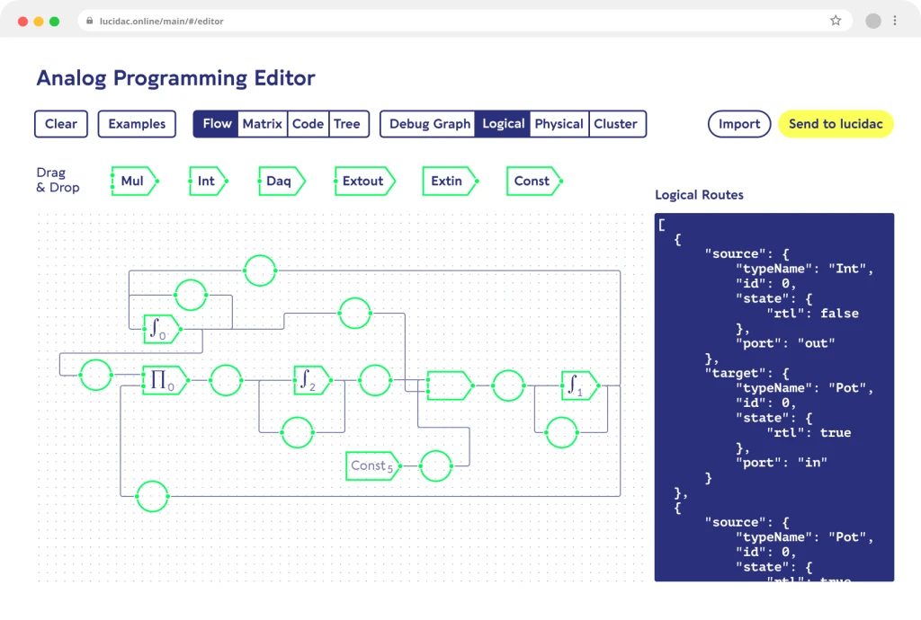
Value Chain from Semi to Cloud
Chip
Package
Board
Drivers
Runtime
Cloud API
Application

Slide 13
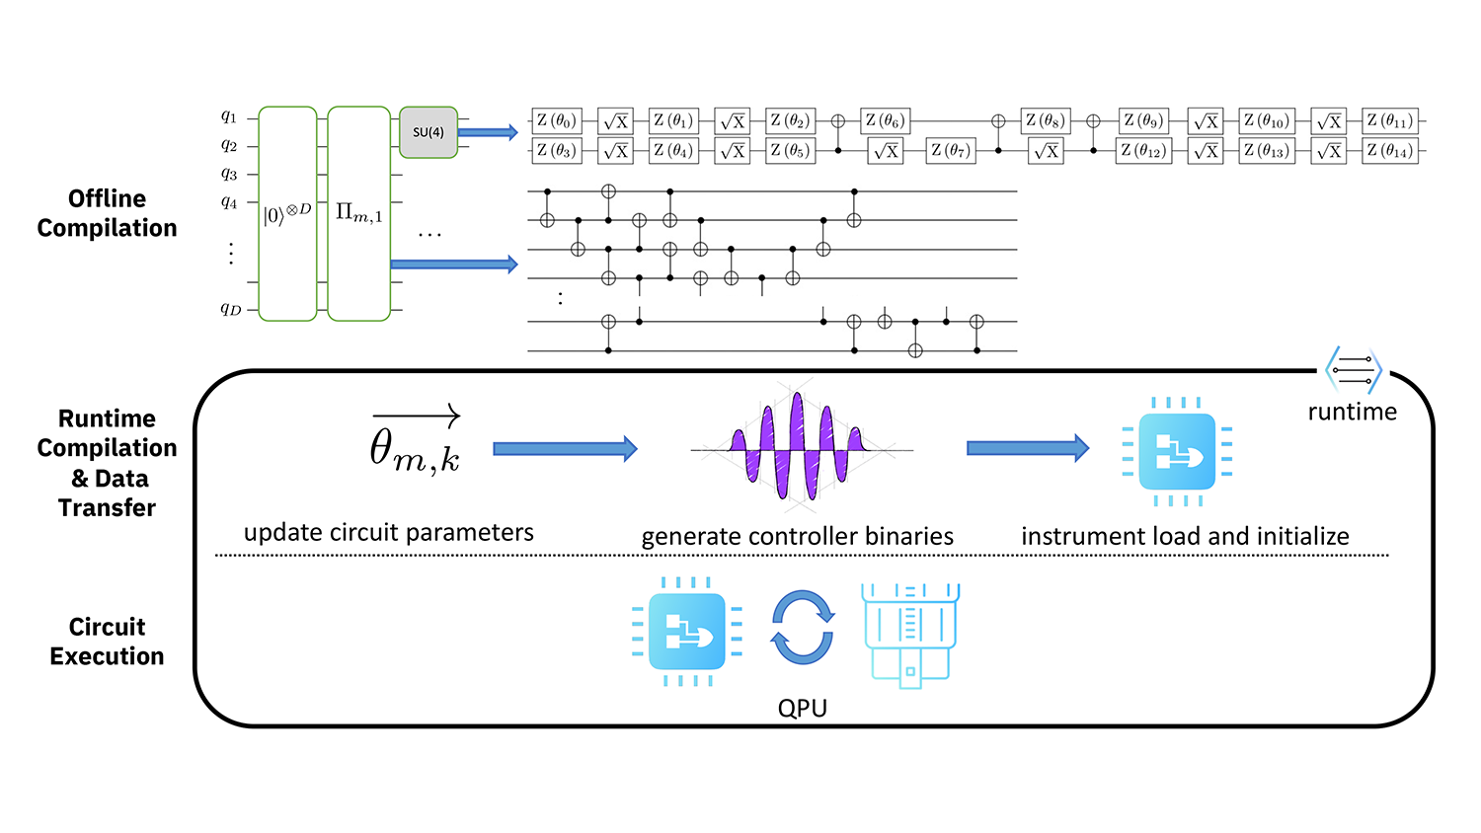
Value Chain from
Semi to Cloud
Chip
Package
Board
Drivers
Runtime
Cloud API
Application

Slide 14
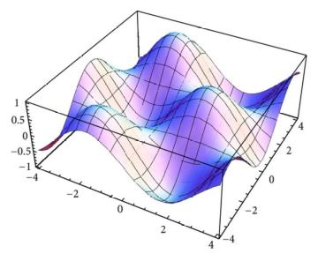



Value Chain from Semi to Cloud
Job Queue:
Submit
Run
Status
Result
H q[0]
CX q[0], q[1]
Measure
Chip
Package
Board
Drivers
Runtime
Cloud API
Application

Slide 15
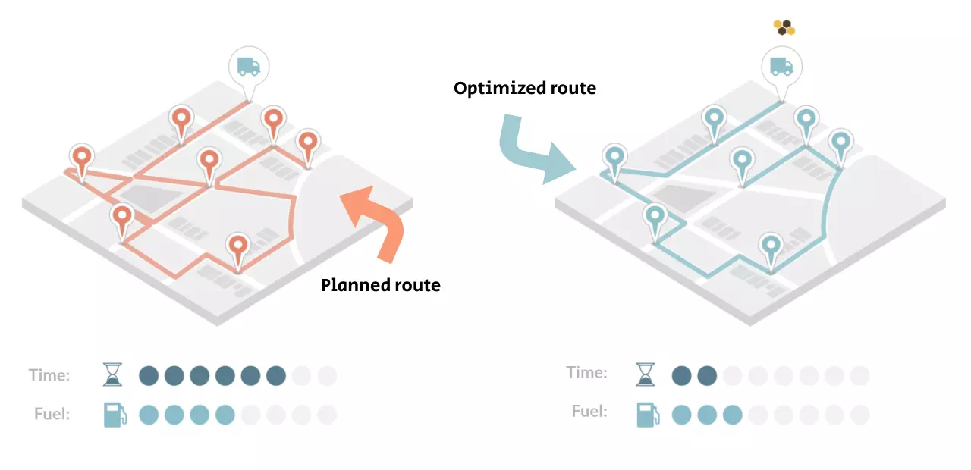
Value Chain from Semi to Cloud
Chip
Package
Board
Drivers
Runtime
Cloud API
Application

Slide 16
substituting
Why Europe’s Cloud Market Should Be Sovereign and Decentralised
David Sterz
david.sterz@denktmit.de
with
Let's build European Clouds on Souvereign Hardware beyond GPUs
Dr. Sven Köppel
sven.koeppel@denktmit.de

Slide 17
Scaling analog CMOS for HPC
Anabrid resets Moore’s law
Circuit Size
[# computing elements]
Cutoff Frequency
[Hz]
Nuclear Fusion
10¹²
10⁹
Growth:
One Decade per Year
...
10⁸
10⁸
Growth:
One Decade per 2 years
HPC
HPC
10⁷
10⁶
10⁷
GPAC2
Drones
10⁵
10⁶
GPAC1
10⁴
REDAC
10³
10⁵
LUCI, REDAC
Embedded
10²
LUCI
Digital limit
10¹
THAT
10⁴
THAT
2020 2022 2024 2026 2028 2030
Time
[year]
2020 2022 2024 2026 2028 2030
Time
[year]

